Slide 1
MapReduce
CSC 4760 / 6760 Big Data Programming
Spring 2018
Chapter 1 Design Patterns and MapReduce. Book: MapReduce Design Patterns, Donald Miner & Adam Shook, 2012.
Slides was modified from (http://grid.hust.edu.cn/xhshi/)

Slide 2
What is MapReduce?
Origin from Google, [OSDI’04]
A simple programming model
Functional model
For large-scale data processing
Exploits large set of commodity computers
Executes process in distributed manner
Offers high availability
MapReduce: simplified data processing on large clusters.
Jeffrey Dean and Sanjay Ghemawat,
OSDI, 2004.

Slide 3
Motivation
Lots of demands for very large scale data processing
A certain common themes for these demands
Lots of machines needed (scaling)
Two basic operations on the input
Map
Reduce
MapReduce: simplified data processing on large clusters.
Jeffrey Dean and Sanjay Ghemawat,
OSDI, 2004.

Slide 4
Distributed Grep
Split data
grep
matches
Split data
grep
matches
Very
big
data
All
matches
Split data
grep
matches
cat
Split data
grep
matches

Slide 5
Distributed Word Count
Split data
count
count
Split data
count
count
Very
big
data
merged
count
Split data
count
count
merge
Split data
count
count
MapReduce: simplified data processing on large clusters.
Jeffrey Dean and Sanjay Ghemawat,
OSDI, 2004.

Slide 6
Map + Reduce
R
E
D
U
C
E
Very
big
data
M
A
P
Partitioning
Function
Result
Map
Accepts input key/value pair
Emits intermediate key/value pair
Reduce
Accepts intermediate key/value* pair
Emits output key/value pair
MapReduce: simplified data processing on large clusters.
Jeffrey Dean and Sanjay Ghemawat,
OSDI, 2004.

Slide 7
Architecture overview
Master node
Job tracker
user
Slave node 1
Slave node 2
Slave node N
Task tracker
Task tracker
Task tracker
Workers
Workers
Workers
MapReduce: simplified data processing on large clusters.
Jeffrey Dean and Sanjay Ghemawat,
OSDI, 2004.

Slide 8
GFS (Google File System): Underlying Storage System
Goal
global view
make huge files available in the face of node failures
Master Node (meta server)
Centralized, index all chunks on data servers
Chunk server (data server)
File is split into contiguous chunks, typically 16 - 64MB.
Each chunk replicated (usually 2x or 3x).
Try to keep replicas in different racks.
MapReduce: simplified data processing on large clusters.
Jeffrey Dean and Sanjay Ghemawat,
OSDI, 2004.

Slide 9
GFS architecture
GFS Master
Client
C₀
C₁
C₁
C₀
C₅
…
C₅
Chunkserver 1
Chunkserver 2
Chunkserver N
C₂
C₅
C₃
C₂
MapReduce: simplified data processing on large clusters.
Jeffrey Dean and Sanjay Ghemawat,
OSDI, 2004.

Slide 10
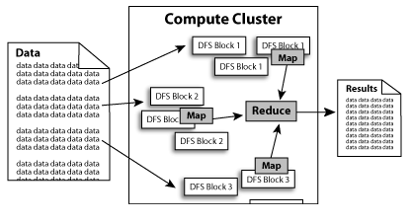
Diagram
MapReduce: simplified data processing on large clusters.
Jeffrey Dean and Sanjay Ghemawat,
OSDI, 2004.

Slide 11
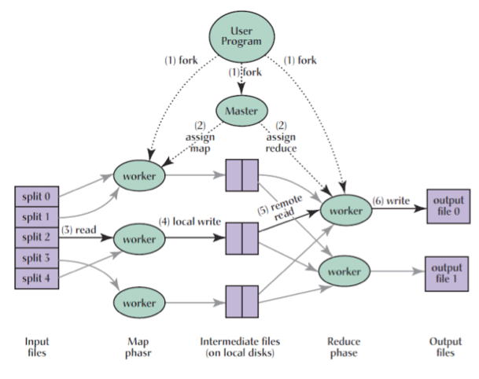
MapReduce Framework
Execution overview

Slide 12
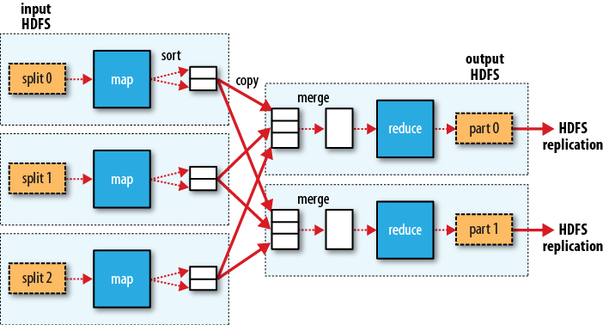
MapReduce data flow in Hadoop

Slide 13
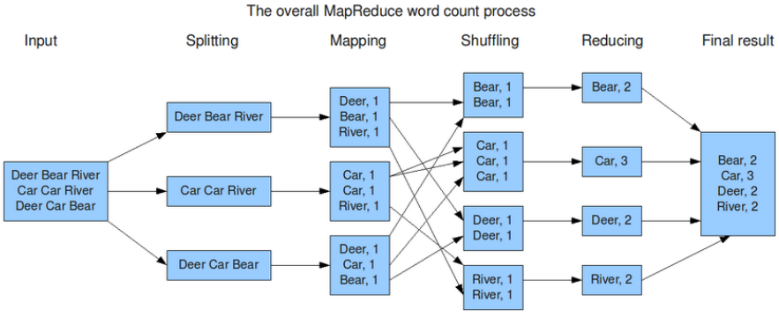
MapReduce: simplified data processing on large clusters.
Jeffrey Dean and Sanjay Ghemawat,
OSDI, 2004.

Slide 14
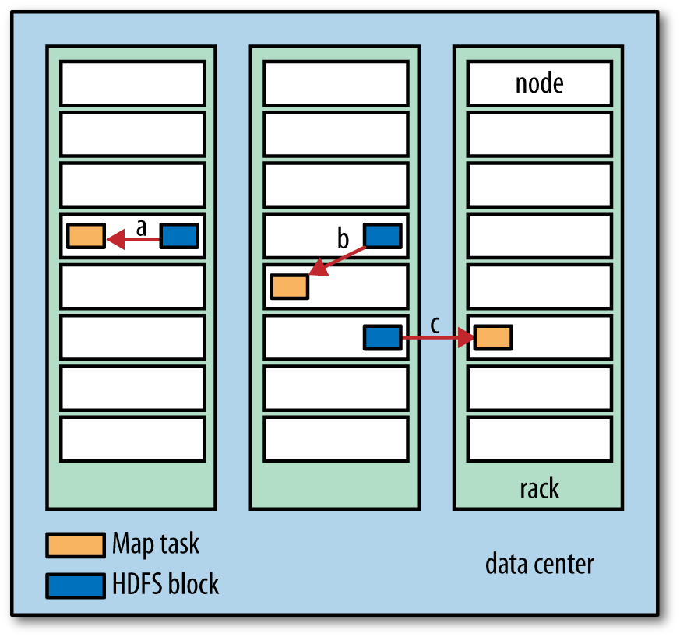
Network Communication Cost is high!
Data-local (a)
rack-local (b)
off-rack (c)

Slide 15
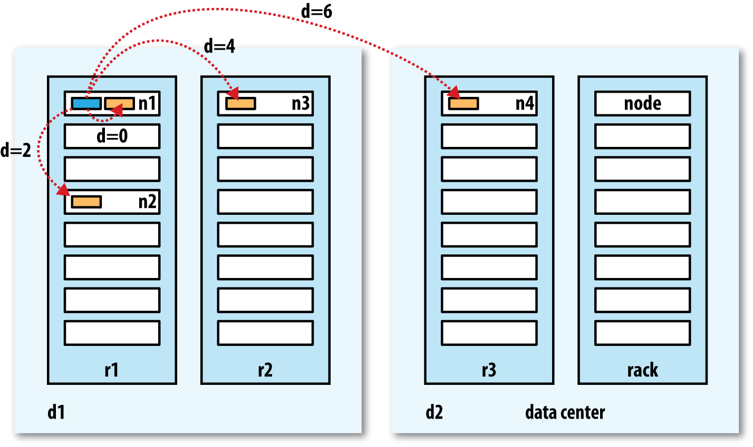
Network Distance in Hadoop
same node
different nodes on the same rack
nodes on different racks in the same data center
nodes in different data centers

Slide 16
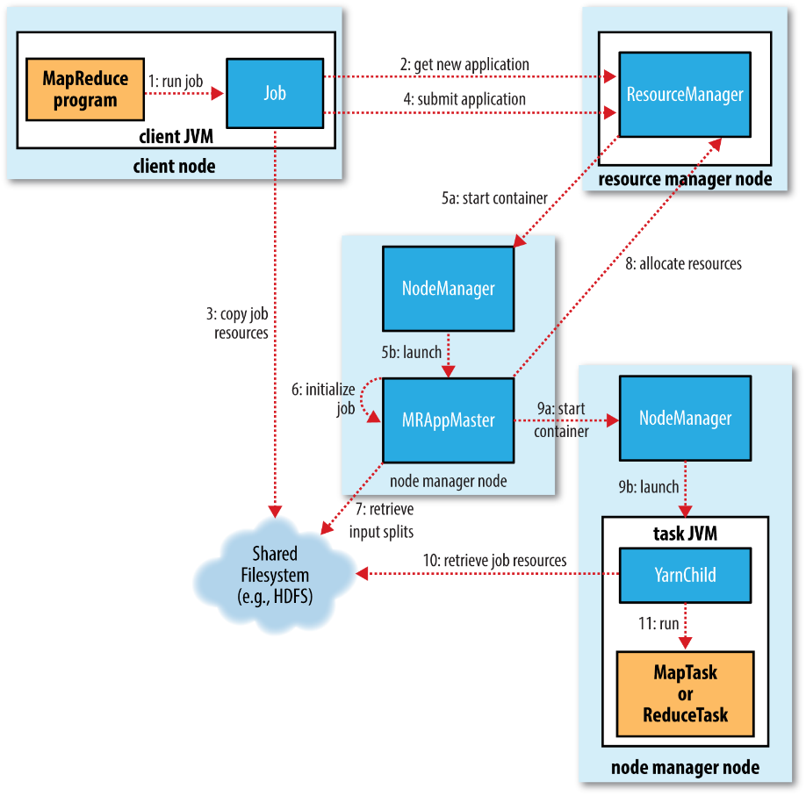
How Hadoop runs a MapRuduce job

Slide 17
A Simple Example: Word Counting
Counting words in a large set of documents
map(string value)‏
// key: document name
// value: document contents
for each word w in value
EmitIntermediate(w, “1”);
reduce(string key, iterator values)‏
// key: word
// values: list of counts
int results = 0;
for each v in values
result += ParseInt(v);
Emit(AsString(result));
MapReduce: simplified data processing on large clusters.
Jeffrey Dean and Sanjay Ghemawat,
OSDI, 2004.

Slide 18
Functions in the Model
Map
Process a key/value pair to generate intermediate key/value pairs
Reduce
Merge all intermediate values associated with the same key
Partition
By default : hash(key) mod R
Well balanced
MapReduce: simplified data processing on large clusters.
Jeffrey Dean and Sanjay Ghemawat,
OSDI, 2004.

Slide 19
Locality issue
Master scheduling policy
Asks GFS for locations of replicas of input file blocks
Map tasks typically split into 64MB (== GFS block size)
Map tasks scheduled so GFS input block replica are on same machine or same rack
Effect
Thousands of machines read input at local disk speed
Without this, rack switches limit read rate
MapReduce: simplified data processing on large clusters.
Jeffrey Dean and Sanjay Ghemawat,
OSDI, 2004.

Slide 20
Fault Tolerance
Reactive way
Worker failure
Heartbeat, workers are periodically pinged by master
NO response = failed worker
If the processor of a worker fails, the tasks of that worker are reassigned to another worker.
Master failure
Master writes periodic checkpoints
Another master can be started from the last checkpointed state
If eventually the master dies, the job will be aborted
MapReduce: simplified data processing on large clusters.
Jeffrey Dean and Sanjay Ghemawat,
OSDI, 2004.

Slide 21
Fault Tolerance
Proactive way (Redundant Execution)
The problem of “stragglers” (slow workers)
Other jobs consuming resources on machine
Bad disks with soft errors transfer data very slowly
Weird things: processor caches disabled (!!)
When computation almost done, reschedule in-progress tasks
Whenever either the primary or the backup executions finishes, mark it as completed
MapReduce: simplified data processing on large clusters.
Jeffrey Dean and Sanjay Ghemawat,
OSDI, 2004.

Slide 22
Fault Tolerance
Input error: bad records
Map/Reduce functions sometimes fail for particular inputs
Best solution is to debug & fix, but not always possible
On segment fault
Send UDP packet to master from signal handler
Include sequence number of record being processed
Skip bad records
If master sees two failures for same record, next worker is told to skip the record
MapReduce: simplified data processing on large clusters.
Jeffrey Dean and Sanjay Ghemawat,
OSDI, 2004.

Slide 23
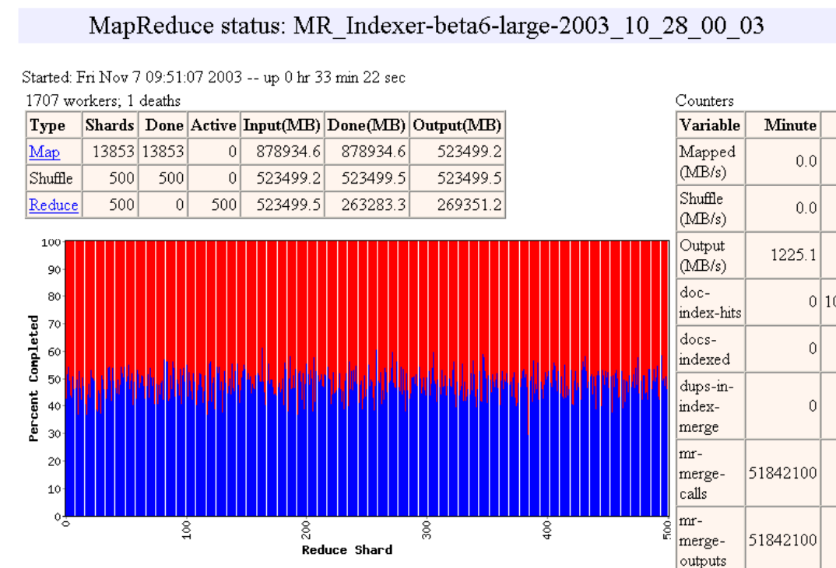
Status monitor 1

Slide 24
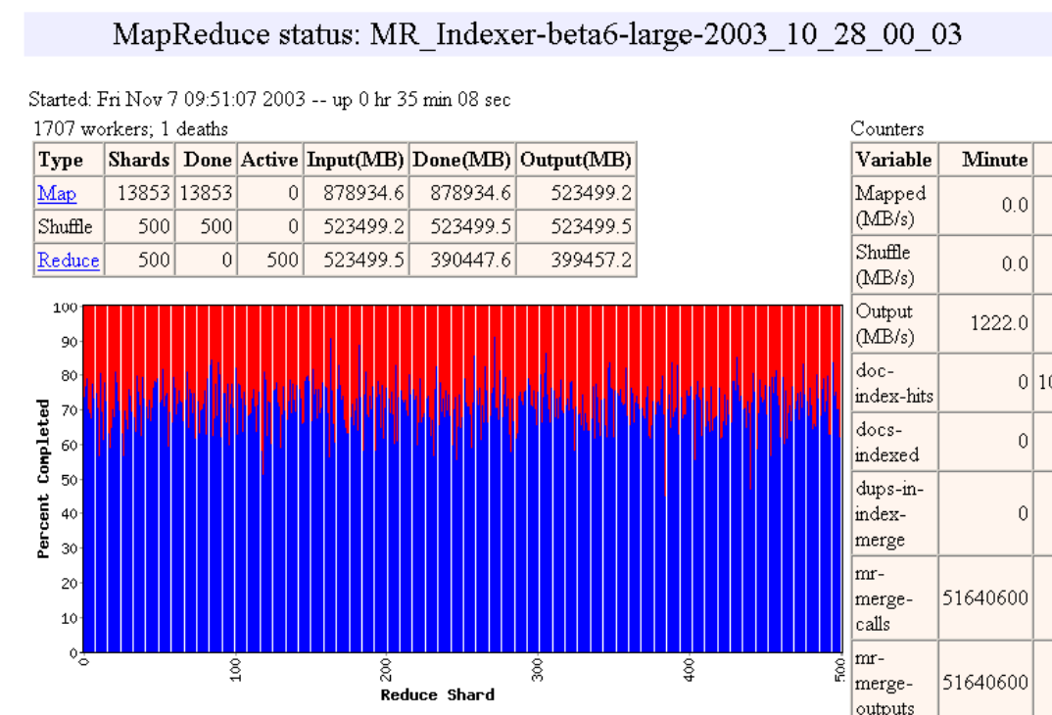
Status monitor 2

Slide 25
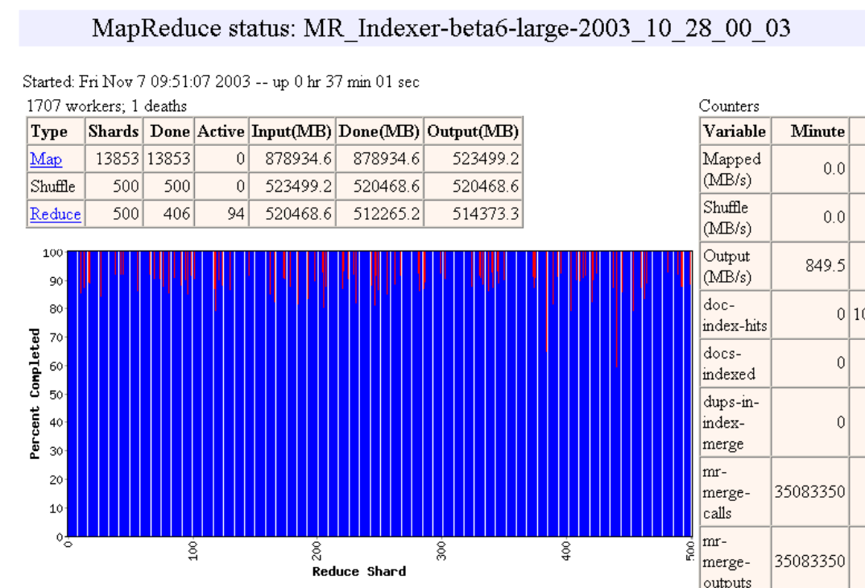
Status monitor 3

Slide 26

Status monitor 4

Slide 27
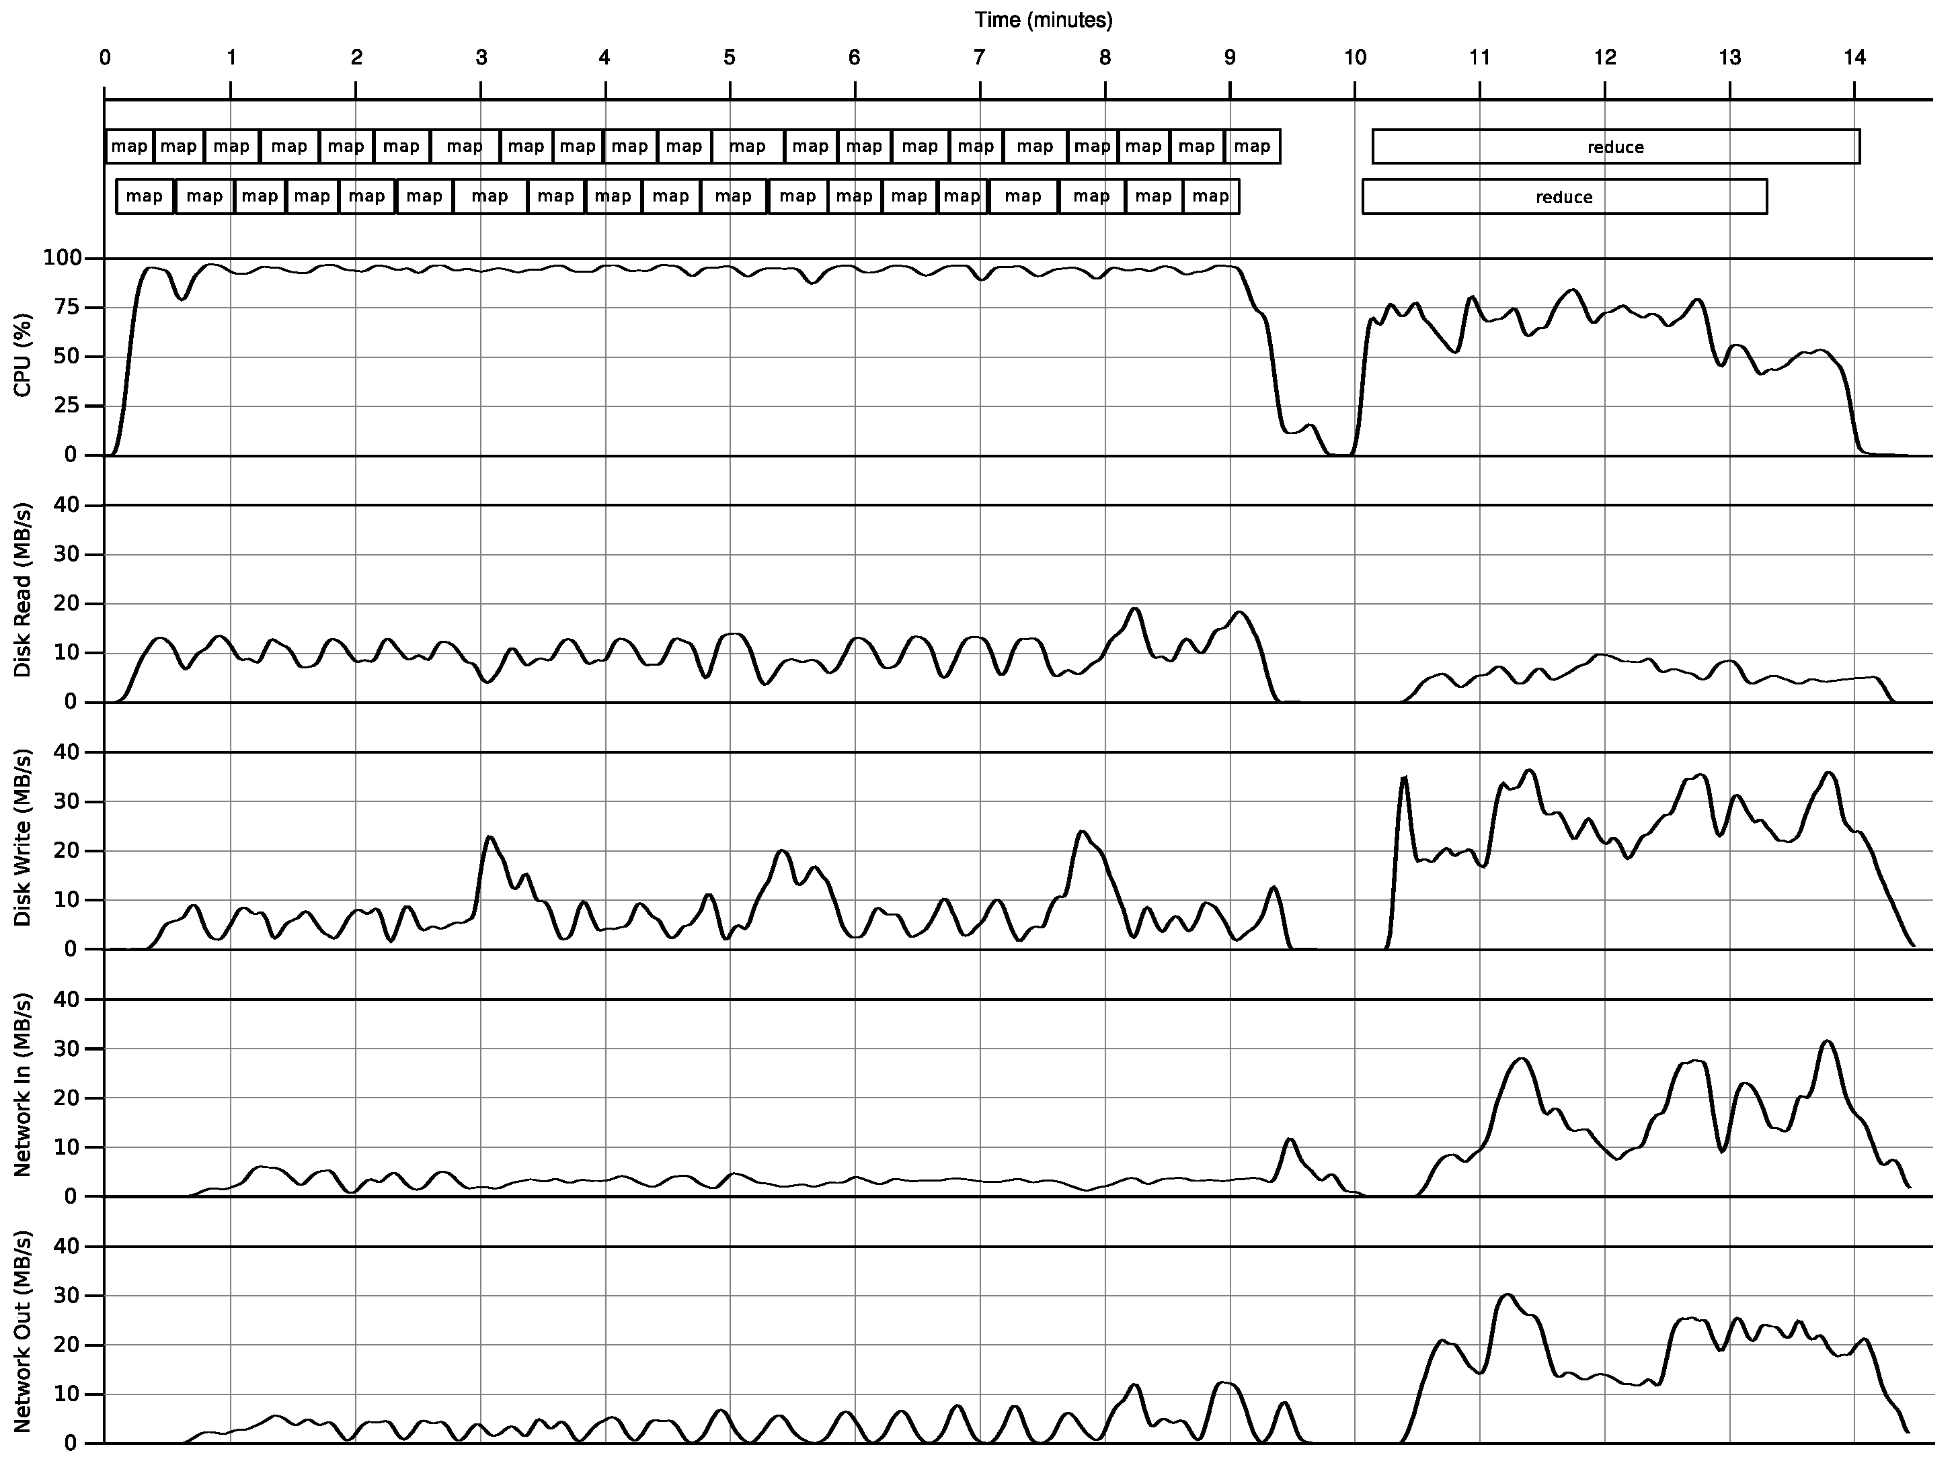
System behavior on a single node
100-node cluster
Each node has a single 2.4 GHz Intel Core 2 Duo processor (That is, each node has two cores)
Hadoop
200 map tasks and 200 reduce tasks
A comparison of join algorithm for log processing in MapReduce
Spyros Blanas, et al
SIGMOD, 2010
A comparison of join algorithm for log processing in MapReduce
Spyros Blanas, et al
SIGMOD, 2010

Slide 28
Refinements
Task Granularity
Minimizes time for fault recovery
load balancing
Local execution for debugging/testing
Compression of intermediate data
MapReduce: simplified data processing on large clusters.
Jeffrey Dean and Sanjay Ghemawat,
OSDI, 2004.

Slide 29
Points need to be emphasized
No reduce can begin until map is complete
Master must communicate locations of intermediate files
Tasks scheduled based on location of data
If map worker fails any time before reduce finishes, task must be completely rerun
MapReduce library does most of the hard work for us!
MapReduce: simplified data processing on large clusters.
Jeffrey Dean and Sanjay Ghemawat,
OSDI, 2004.

Slide 30
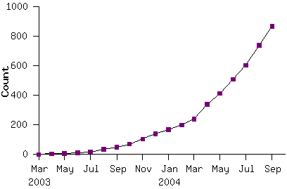
Model is Widely Applicable
MapReduce Programs
Examples as follows
distributed grep |  | distributed sort |  | web link-graph reversal
term-vector / host |  | web access log stats |  | inverted index construction
document clustering |  | machine learning |  | statistical machine translation
... |  | ... |  | ...
MapReduce: simplified data processing on large clusters.
Jeffrey Dean and Sanjay Ghemawat,
OSDI, 2004.

Slide 31
How to use it
User to do list:
indicate:
Input/output files
M: number of map tasks
R: number of reduce tasks
W: number of machines
Write map and reduce functions
Submit the job
MapReduce: simplified data processing on large clusters.
Jeffrey Dean and Sanjay Ghemawat,
OSDI, 2004.

Slide 32
Applications
String Match, such as Grep
Reverse index
Count URL access frequency
Lots of examples in data mining
MapReduce: simplified data processing on large clusters.
Jeffrey Dean and Sanjay Ghemawat,
OSDI, 2004.

Slide 33



MapReduce Implementations
MapReduce
Cluster,
1. Google
2. Apache Hadoop
Multicore CPU,
Phoenix@Stanford
GPU,
Mars@HKUST
MapReduce: simplified data processing on large clusters.
Jeffrey Dean and Sanjay Ghemawat,
OSDI, 2004.

Slide 34

Hadoop
Open source
Java-based implementation of MapReduce
Use HDFS (Hadoop Distributed File System) as underlying file system
MapReduce: simplified data processing on large clusters.
Jeffrey Dean and Sanjay Ghemawat,
OSDI, 2004.

Slide 35
MapReduce Implementations
Google | Yahoo!
MapReduce | Hadoop
GFS | HDFS
Bigtable | HBase
MapReduce: simplified data processing on large clusters.
Jeffrey Dean and Sanjay Ghemawat,
OSDI, 2004.

Slide 36
2008 news about Hadoop
The cluster statistics were:
Apache Hadoop Wins Terabyte Sort Benchmark
One of Yahoo’s Hadoop clusters sorted 1 terabyte of data in 209 seconds.
First time that either a Java or an open source program has won.
The sort used 1800 maps and 1800 reduces and allocated enough memory to buffers to hold the intermediate data in memory.
910 nodes
2 quad core Xeons @ 2.0ghz per a node
4 SATA disks per a node
8G RAM per a node
1 gigabit ethernet on each node
40 nodes per a rack
8 gigabit ethernet uplinks from each rack to the core
Red Hat Enterprise Linux Server Release 5.1 (kernel 2.6.18)
Sun Java JDK 1.6.0_05-b13
http://yahoohadoop.tumblr.com/post/98115409811/apache-hadoop-wins-terabyte-sort-benchmark
http://sortbenchmark.org/

